Slide 1
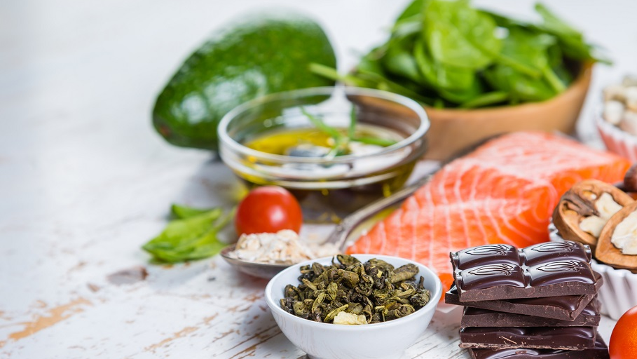
Salad Mixer!
Salad Made Easy
& Delicious !
Join US
1:00pm – 3:00pm Saturday 25th Feb
3207 West Gate Lane, Richardson TX 75092
Please RSVP Bring 4 Mason Jars Bring 2 to 3 Salad!

Slide 2
Salad Mixer!
Start Your New Year with Good Habits!
Customize Your Own Salad
Healthy Dressing
Kick Start Your Detox
Repair Your Digestive System
Make Eating Healthy Fun
Salad Made Easy
& Delicious !
1:00pm – 3:00pm Sunday 25th Feb
3207 West Gate Lane, Richardson TX 75092
Please RSVP:
Roseanna @ 817 688 8229 Bring 4 Mason Jars Bring 2 to 3 Salad!

Slide 3
HOW TO GET A SALAD MIXER STARTED?

Slide 4
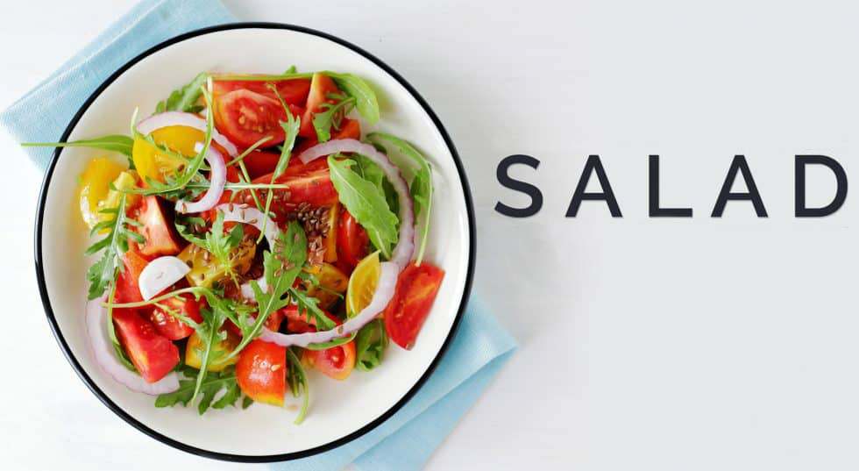
Learn to make your GREENS
the creative way at our
MIXER
Start Your Day with Good Habits!
Customize Your Own Salad
Healthy Dressing
Kick Start Your Detox
Repair Your Digestive System
Eating Healthy can be Fun!
SATURDAY 28st April 2018
12-2 PM
Irving MYOTHERAPHY
2940 N. O’Connor Rd, Ste. 117
Irving TX 75062
927-600-9003
Bring 4 Mason Jars Bring a type of greens (already cut) to add to salad!

